Slide 1

Plenty of Fish
Team #1
Grace Cappiello, Kate Difilippo, Alexandra Godown, Cameron Hnaiti, Owen McCloskey, Martina Rabade, & Jessica Rozo

Slide 2
We asked singles about their dating app experiences.
A few questions asked in the survey and why
What would be your go to dating app?
Show our competitors and what we should strive for
What do you think dating apps are missing?
What consumers are seeking to fulfill
What made you stop using a dating app?
Helps understand reason of leaving and competitors’ mistakes
Since COVID-19, has your perspective on dating apps changed?
Helps recognize new patterns and preferences in dating
What is your biggest concern using dating apps?
Highlights the main worries amongst users
Our findings (32 respondents ages 18-24)
What would be your go to dating app?
Tinder
What do you think dating apps are missing?
Verification of info/safety
What made you stop using a dating app?
Scared of people on app
Why did you use the app?
Casual hookups
What is your biggest concern using dating apps?
Security
Since COVID-19, has your perspective on dating apps changed?
Still, people would not use dating apps and might be more afraid to
Martina

Slide 3
We found that most users are concerned about safety.
What research shows
People mostly use these apps for casual hookups, but their biggest concern is security and safety.
Due to COVID-19, people have become more reluctant to use dating apps.
Many participants stated that there should be an increase of identity verification measures for individuals.
“Creeps,” as many respondents described, would be reduced
What we should do to cater to the research
Invest more time and effort in security measures
Mitigate the issue of security and safety by asking security questions, requiring special identification, and photo verification. In doing so, users could have more confidence on dating app.
Martina

Slide 4
Pew Research shows young women are highly susceptible to harassment on dating apps.
Young women are more susceptible to harassment or unwarranted contact on dating apps
“Six-in-ten female online dating users ages 18 to 34 say someone via a dating site or app continued to contact them after they said they were not interested”
“57% report that another user has sent them a sexually explicit message or image they didn’t ask for.”
“19% of younger female users say someone on a dating site or app has threatened to physically harm them”
“Women are more inclined than men to believe that dating sites and apps are not a safe way to meet someone (53% vs. 39%)”
Owen, Martina

Slide 5
Scholarly research shows we need to invest in our mobile app, with a focus on safety and security measures.
Plenty of Fish reported 70% of users use their mobile app as opposed to their web client
We need to invest more of our resources in the mobile app
Our primary focus is on improving security measures to increase user comfort
Although mobile dating apps have made it easier to connect with potential partners, these benefits do not come without considerable risk, for example:
Fraud, deception, stalking and being vulnerable to kidnapping, sexual assault and even murder. In the United Kingdom, two separate murder investigations identified that the criminals involved used mobile dating apps, such as Plenty of Fish and Grindr to lure their victims.
Plenty of Fish FAILING to prevent crime related to its use shows that we need to invest more in security measures.
Security measures will include the requirement of ID scanning and photo verification for users.
Owen, Martina

Slide 6
We interviewed users about their dating app experiences, these are our positive findings.
Caroline, Female 20
woman interested in men
Went out on a date with a guy for the first time, went on a boat and had a really great
day all for just a hookup. Easy to meet nice, adventurous guys just looking for company.
Not currently using dating apps because she is in a relationship found through Hinge for the past four months.
She heard from her friends that Tinder wasn’t great and that Hinge had better guys between (22-25), her preferred age range
She would be willing to try an app that she never heard of if she was single, but this is only due to Covid. She usually would not try online dating due to safety/security scares.
She would enjoy finding people that she is chosen to meet under advanced algorithms. She also values the importance of being able to sort through potential date options and find the guy she wants to go out with.
She trusts dating apps to a certain extent. If she was going out to meet a guy for lunch, she would always send her friends her location as an extra layer of security. She gets nervous about the date being a crazy person.
She likes apps that are fun while being fairly straight to the point. She does not like wasting her time on filling out lengthy questionnaires, she would rather take a short quiz to have her preferences known.
Caroline would not use more than one dating app at a time, she feels like it would be too much work and very time consuming. She has also heard through her friends that many of the same people are on different apps, so it can get repetitive.
Julie, Female 22
She has used Tinder and Hinge
Preferred Hinge more because of the use of filters to help narrow down her options
Ethnicity filters, smoking filters, area filters, etc.
She met current boyfriend off of Hinge during COVID period
Currently not using dating app because she is in a relationship
No, she would not use unfamiliar apps because she feels they are unsafe
Would like a more custom algorithm based app to fit her preferences
Yes she trusts dating apps
Would not use more than one dating app at a time. Used to use Tinder for more hook up style and signed up for Hinge for more relationship purposes and meaningful connection.
Grace, Lexie

Slide 7
Other users have had unpleasant online encounters, most of them involving safety and security.
Dalia, Female 20
Has used Tinder in the past
Experience: has felt unsafe during one meet up with sketchy guy that turned her off of the idea of dating apps
Not currently using dating app because in a relationship
Would use Tinder or BlackPeopleMeet.com
Algorithm? Yes because it would fit to her specific need of types
Her type is hispanic, lightskin, and African American
“I trust dating apps but not the people and their intentions”
She believes dating apps should include a friendship option
Thinks there should be a contact sync up to see who she knows is also on the app and find people she is familiar with
Would not use more than one dating app
Peter, Male 20
Got catfished by a girl, she was not even the same person on the photos.
Tinder
He only uses tinder because he trusts the app and knows all his friends use it.
Yes, he would prefer it. He has a certain type ( blonde, shorter, ) cause he’s on the shorter side.
No he doesn't trust dating apps, because he uses it as a joke and feels people are on there for fun and not looking for love.
He would rather use apps that are fun and interactive, it makes things less awkward and everyone on that app will be on the same page.
He would use more than one dating app, he thinks its fun and easy to keep himself occupied.
Cameron, Grace

Slide 8
Beyond safety, these are other main issues users have with dating apps.
This article highlights other issues found on dating apps that do not involve security, but touch on the topics:
Time consuming (“like a part-time job”)
Silence on dates (chatting → radio silence)
Mismatching people
First dates feeling like interviews
The risk of security is always prevalent in our research
Considering these issues, our goal is to develop an option to:
Mitigate matching and date failures
Make users time worth it
Increase efficiency
Make it as natural as possible
Lexie, M
Martina

Slide 9
Why do people use dating apps? We found out.
More than one-third (37%) of internet users in the U.S. have used a dating app in the last six months
“Dating apps offer solutions and add to dating world woes, allowing people to connect with a seemingly infinite dating pool.”
“Women are most likely to “swipe right” on a potential match if the person exhibits similar interests (33%), while men are most likely to “swipe right” if the person is attractive (40%).”
People download dating apps because they are:
curious (29%), want something convenient (19%), are bored (15%), are lonely (12%), or are hopeful (12%)
5% of dating apps users download dating apps because they want to “rebound” from a recent breakup.
Lexie

Slide 10
We are trying to market to this target demographic.
Ages 18-24, regularly using dating apps
People looking for casual hookups
People who want more security in an online dating app
People desiring inclusivity in the dating scene in relation to self expression/identification (race, sexual orientation)
Key Insight about the Target
64% of 18 to 24 year-olds say that dating websites and apps allow them to be more diverse in who they date.
41% of 18 to 24 year-olds learn about dating apps through online video sites, over 57% more than 25 to 34 year-olds.
69% of dating app users are male
37% of people in the U.S. have used a dating app in the last 6 months
11% of dating app users have deleted a dating app because they felt unsafe using the platform
Lexie

Slide 11
We have developed a creative strategy brief according to our secondary research.
Target Problem
Dating apps are not up to par with security and user identities. Users are concerned about the lack of safety and security on dating apps.
Key Competition
POF key competitors include: Tinder, Bumble, Hinge, Grindr
Based on survey results, Tinder is most popular followed by Hinge
Positioning Statement
For people fishing for a temporary or lasting connection in a fun, engaging, trustworthy, and SAFE manner
Brand Advantages
POF should leverage its creative name
Big international presence
Lifestyle blog for self-development
Virtual speed dating
Able to choose who can contact them Everyone

Slide 12
The following is a continuation of our creative strategy brief...
Brand Opportunities for Improvement
Leans more to one age group, older demographic
No emphasis on sexual orientation and inclusivity
Lacking photo verification tool
What We Want Targets to Do
We want the target to feel safe when choosing their perfect fish, without worrying about safety. We want users to log onto the app, create an account, scan ID and face compatibility with ID.
Unique Selling Proposition
We are the only dating app that requires ID verification to ensure users can safely find their match.
Everyone

Slide 13
This is our insight and message which is based around user safety and security...
Insight:
Based on our research, we found that most users of dating apps are concerned about their safety and security
Message:
We want to prioritize our users’ safety. Therefore, we will require all users to upload a photo of their face and ID to prevent fraud and mitigate harm.
Lexie, Martina, Owen, Cameron, Grace

Slide 14
We want to base our organizing idea around an antagonist named Fishy Joe...
We will base our executions around a catfish antagonist named Fishy Joe, who embodies all bad behavior on dating apps. Fishy Joe attempts to join a group of happily dating fish but is foiled by the security measures of Plenty of Fish.
Lexie, Martina, Owen, Cameron, Grace

Slide 15
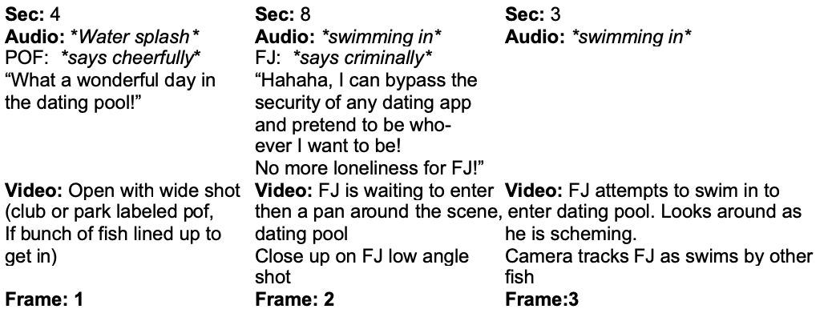
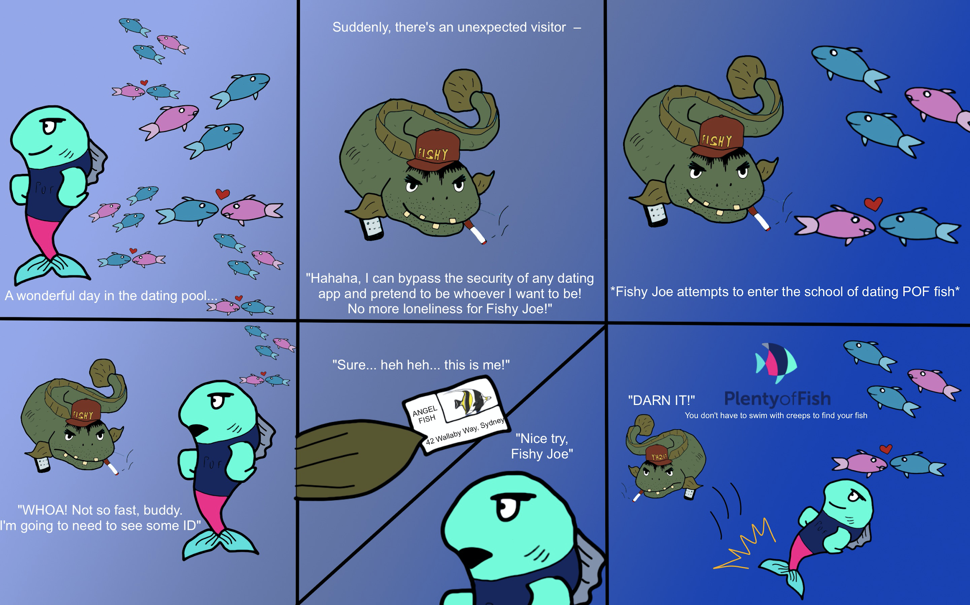
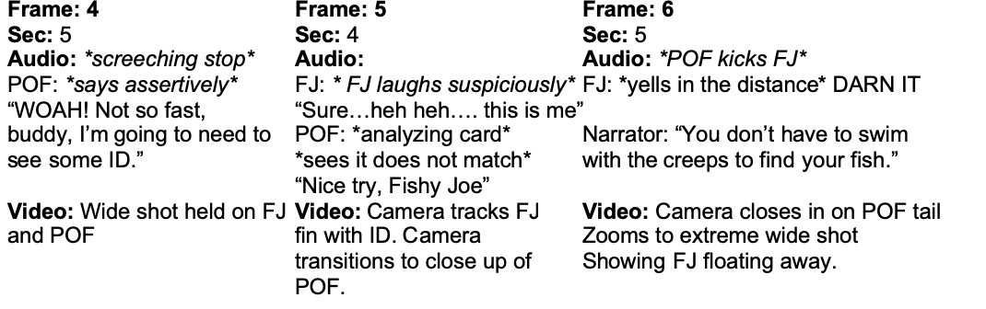
This is our storyboard for a Fishy Joe commercial execution...
Owen, Jess

Slide 16
We asked potential users their thoughts about our new safety features.
Features- Plenty of Fish will now have new security features. Those who do not successfully pass will be denied use of the app.
Advantages- We are increasing security measures by including ID scanning and photo verification in the app.
Motives- People will gain confidence in dating apps and feel more secure about the people they potentially come in contact with. The stigma against dating apps being dangerous will dissipate.
Benefits- According to our research, 56% of dating app users do not feel safe while using the apps. With the increased security measures, we will reduce the amount of fake users wanting to explore the app, as well as those people who catfish others. We will see more people making meaningful connections and getting the most out of their experience with Plenty of Fish because users will feel more comfortable and secure.
Martina, Lexie

Slide 17
These were the questions we used for our concept test...
Questions to ask public:
How much do you like this proposal?
Love, like, neither like or dislike, dislike, hate
How likely are you to trust the proposal?
Very likely, likely, neither likely or unlikely, unlikely, very unlikely.
How unique is this feature to the online dating service industry?
Very unique, somewhat unique, not unique
How beneficial will this feature be to dating apps?
Highly beneficial, somewhat beneficial, not beneficial
How willing are you to try out the service?
Very willing, somewhat willing, not willing.
Do you have any remaining thoughts or opinions about this proposal?
Open answer
Martina

Slide 18
...and these were the results for our concept test.
Our sample size of 20 people gave the following results:
90% of respondents either love or like the proposal
85% would be likely or very likely to trust it
90% believe it is very unique or somewhat unique
95% believe it would be either highly or somewhat beneficial
90% would be somewhat or very willing in trying it out
In our open-ended question, one user stated:
“I have not used Plenty of Fish before but this sounds like a really good security measure for those types of apps to start doing.”
Martina

Slide 19
This is our budget plan for our paid media.
Digital/Online Print Media - $700,000 (7%)
Social Media - $2,000,000 (20%)
Streaming - $3,000,000 (30%)
Traditional Media - $1,900,000 (19%)
SEO & SEM - $100,000 (1%)
Influencers - 1,900,000 (19%)
Production Cost - $500,000 (5%)
Additional Media - $2,000,000
Allocated Budget:
$10,000,000
Additional Media:
$2,000,000
Lexie, Martina, Grace, Owen

Slide 20
This is where we will allocate the funds for our paid media
Digital/Online Print: $700,000
Banner/Display Ads - $500,000
Most popular form of digital ad and surpass TV
Email Marketing - $100,000
Emails featuring POF special events and offers
SEO - $50,000
Search Engine Opt increase its effectiveness by 40%
SEM - $50,000
75% say paid search ads make it easier to find the info on a website or search engine.
Streaming: $3,000,000
Spotify - $500,000
15-30 second audio and display ads
Hulu - $1,000,000
32 million people view Hulu with ads
15-30 second video streamed
Amazon Prime - $200,000
81% internet users (10-34) have an amazon prime membership
15-30 ad videos on movies
Youtube - $1,200,000
77% internet users used Youtube in 3rd qtr of 2020
15 second ad prior to watching desired youtube video
Apple Podcast - $100,000
56% of users (18-34) not bothered by ads on podcast
15-30 sec ads on romance podcasts
Additional Media: $2,000,000
Experiential- $750,000
Youtube- $750,000
Billboards- $500,000
Traditional Media: $1,900,000
Billboards - $1,700,000
71% of Americans consciously look at billboard ads
Radio - $200,000
71.2 million adults (18-34) use radio every month
30 second ad in peak hours
Influencers: $1,900,000
Experiential - $1,400,000
Speed dating zoom event + gift as incentive
Brand Ambassadors - $200,000
At Uni to promote to college students + events to meet people
Famous Brand Ambassador -$300,000
To share experience of success by using the app
Social Media: $2,000,000
Instagram - $600,000
75% of 18-24 year olds use Instagram
Facebook - $400,000
76% of 18-24 year olds use Facebook
Twitter - $200,000
44% of 18-24 year olds use Twitter
TikTok - $700,000
60% of TikTok users are between ages 16-24
LinkedIn - $100,000
17% of 18-24 year olds use LinkedIn
Martina, Lexie, Grace

Slide 21
These are the strategies we will be using in our paid media.
Digital/Online Print:
Pay for placement in digital blogs and run banner ads on popular news sites that cater to our demographic (Buzzfeed, People).
Social Media:
Run sponsored newsfeed ads and promote our own posts, including Fishy Joe comics and safety tips on online dating apps.
Traditional Media:
Display our unique selling proposition on billboards and have different comics of Fishy Joe attempting to violate dating app rules. Media will be displayed on subways, buses, and billboards.
Streaming :
Run our Fishy Joe executions on video streaming services, 15-30 second ads.
Owen, Lexie

Slide 22
These are the strategies we will use for our owned media...
Social Media
Instagram
2 posts a week sharing stories of couples who have met through plenty of fish. Post stories everyday on POF updates, embracing safety, and have live stream events once a month. Respond to viewers on the page
Facebook
2 posts a week with POF updates, promoting POF, and share peoples’ stories. Post daily stories with “Fishy Joe”, and tips and tricks about safety on online dating apps .
Twitter
One tweet a day engaging with the target audience, giving updates on POF, and sharing matches. Respond to users’ tweets.
TikTok
Post at least 1 video a day highlighting POF offers, sharing matches, and displaying Fishy Joe adverts that promote safety.
Digital
Email Marketing
1x per week, promo email stating the theme or special online events/ reminder to use app
Microsite
Display our new security feature for POF and make sure it is adequate with our target audience
Martina, Lexie, Owen

Slide 23
These are the strategies we will use for earned media
Social Media
Gain influence on social media and attain influencer endorsements
Post real-life accounts of POF users on social media and in blogs
Digital/Online Print
Featured in magazines and online articles like:
Buzzfeed, Barstool, People, GQ, Cnet.com, New York Post, Vice, Business Insider.
Martina, Lexie, Owen, Cameron, Grace

Slide 24
This is what we recommend for Plenty of Fish to implement in the next 1-3 years.
After focusing on security measures, POF should consider:
Increasing the promotion of inclusivity
Make every gender, race, age, sexual orientation, etc. feel welcomed
Embracing hookup culture
Attract a younger crowd
Keep POF playful, fun brand
Covid-19 Awareness
Encourage wearing a mask
Maintaining social distancing when possible
Lexie, Martina

Slide 25
Thank you! Please reach out with any questions.

