Slide 1
Composite Health Care System Overhaul
Database Management
By Elysha A., Alexandra Godown,
Marc M., & David R.

Slide 2
What is CHCS?
A medical database for patients using the Military Health Care system
  organize & analyze health records to improve healthcare outcomes
    deals with the resources, devices and methods to utilize acquisition, storage, retrieval, and use of information in health and medicine

Slide 3

What is CHCS?
Keep a historical record of health care
Check a patient's eligibility for medical appointments
Reduce the risk of illegible orders
Perform drug interaction and appropriateness checks

Slide 4

Target Market
Those within the military
  Seeking medical attention
    Appointment
    Medication
CHCS supports 63 military hospitals, almost 800 military clinics, 77,000 active users, 134,000 daily encounters, and 9.4 million beneficiaries with clinical data.

Slide 5

Business Problems
Duplicate entries
Slow and Clunky
  Hard to work with and update
Lack of:
  customizable reporting
  transparency

Slide 6
Our Solution to Interface Issues
CHCS does not have a modern graphical user interface
  a visual way of interacting with a computer
    windows, icons, and menus
      used by most modern operating systems
We need an updated system that is more efficient
  quickly pull patient information
  experience minimal error in the data
    dangerous for their patients
      incorrect treatments = new health issues

Slide 7
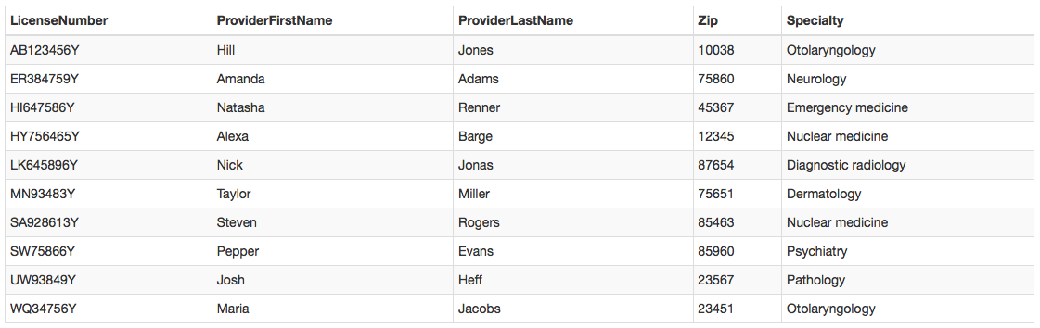
Database → Doctor

Slide 8
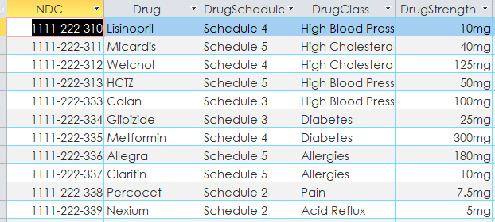
Database → Drug

Slide 9
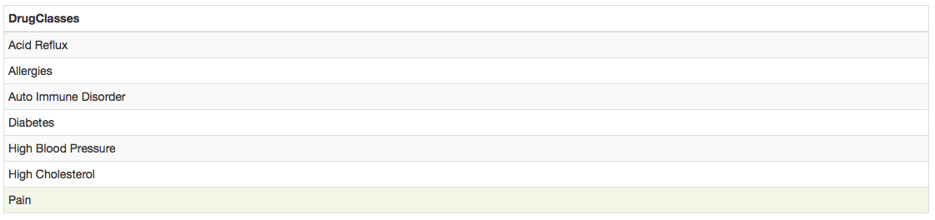
Database → Drug Class

Slide 10
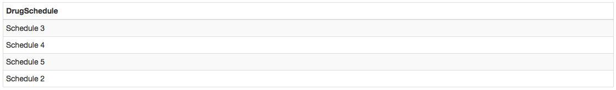
Database → Drug Schedule

Slide 11
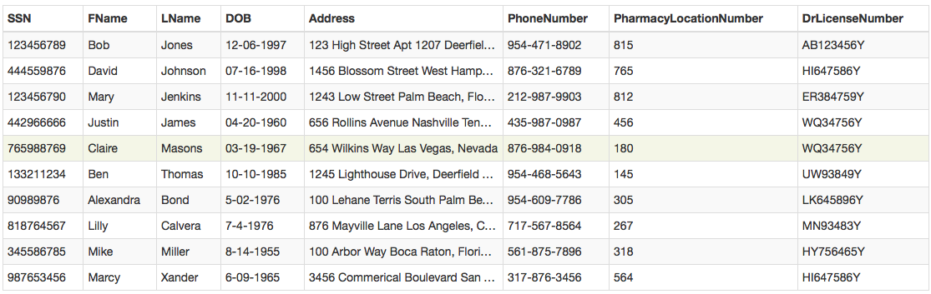
Database → Patient

Slide 12
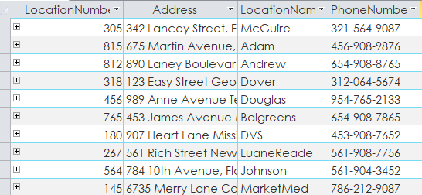
Database → Pharmacy

Slide 13
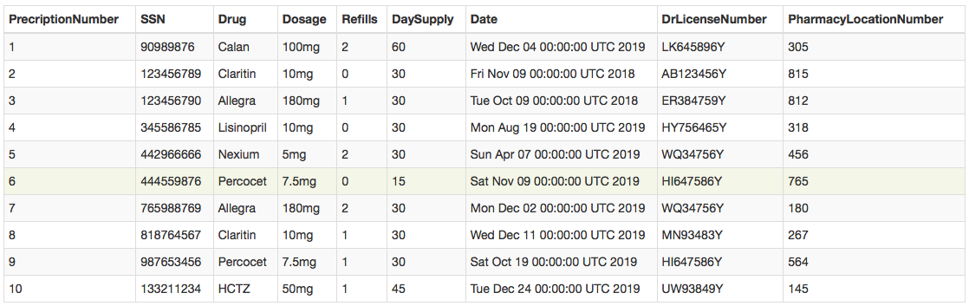
Database → Prescription

Slide 14
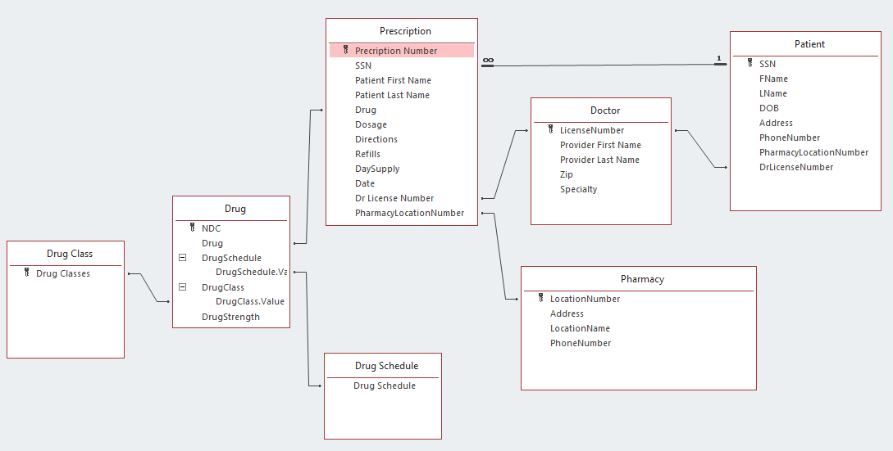
ER Diagram

Slide 15
Questions?

